Slide 1
Program Structures
© 2012 John Sefcovic and Oakland Community College.

Slide 2
Program Structures
Studio 5000 has Tasks, Programs, and Routines.
Studio 5000
TASKS
PROGRAMS
ROUTINES

Slide 3

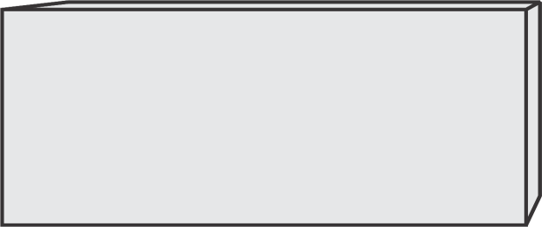

Program Structures
Studio 5000
Tasks are the top level of the programming structure. One Task is continuously scanned, the other Tasks are scanned based on a predetermined Periodic time or Event.
It is not unusual to have just the one continuously scanned Task, with one Program and multiple Routines in an application.
TASK
PROGRAM
ROUTINE

Slide 4

Program Structures
Studio 5000
APPLICATION
In the Application there is one Continuous Task which scans its Programs and called Routines.
CONTINUOUS
TASK
The Continuous Task executes repetitively, unless a Periodic or Event Task interrupts the scan.

Slide 5
Program Structures
Studio 5000
APPLICATION
PERIODIC
TASKS
CONTINUOUS
TASK
A Periodic Task is invoked based on a specified time period and priority. The Task scans its Programs and called Routines.

Slide 6
Program Structures
Studio 5000
APPLICATION
EVENT
TASKS
PERIODIC
TASKS
CONTINUOUS
TASK
A Event Task is invoked based on a specified change of state and priority. The Task scans its Programs and called Routines.

Slide 7

Program Structures
Studio 5000
TASKS do not contain any instructions, they are organizational blocks with defined execution functions.
PROGRAMS do not contain any instructions, they are organizational blocks.
CONTINUOUS TASK
PERIODIC TASK
PROGRAM
ROUTINE
PROGRAM
EVENT TASK
ROUTINE
PROGRAM
ROUTINE
Only the ROUTINES contain instructions.
PROGRAM
ROUTINE
PROGRAM
ROUTINE
PROGRAM
ROUTINE

Slide 8


Program Structures
Studio 5000
TASK
PROGRAM
A Task must contain one Programs.
Programs are scanned in the order listed in the Controller Organizer.
PROGRAM
Additional Programs may be added to the Task.

Slide 9
Program Structures
Studio 5000
Programs are used for:
To organize the application into functional areas.
To sequence when logic is to be executed.
To create local data tags.
Additionally, Programs can be disable from executing by the user in Controller Organizer or automatically by logic instructions.
To decrease scan time by running program only when need.
For application diagnostic programs use occasionally.

Slide 10
Program Structures
Studio 5000
TASK
PROGRAM
Each Program may have local data Tags, used by the program’s Routines.
Local Tags
Tags cannot be shared between Programs.
PROGRAM
The data Tags can only be used by the Routines in the Programs where the Tags were defined.
Local Tags

Slide 11
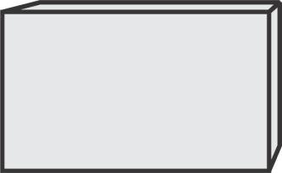
Program Structures
Studio 5000
TASK
PROGRAM
ROUTINE
Only the Routine contains the logic.
The Tasks and Programs organize when the Routines logic is executed.
PROGRAM
ROUTINE

Slide 12
Program Structures
Subroutines or Routines are only scanned when called.
A subroutine can call another subroutine.
Subroutines or Routines are used for:
When the same logic is used repetitively.
To reduce over-all scan time of the processor.
To organize program into functional segments.

Slide 13
Program Structures
Studio 5000
TASK
PROGRAM
ROUTINE
The Program may have additional called Routines.
Routines cannot be called between Programs.
PROGRAM
ROUTINE
Each Program may have called Routines.

Slide 14
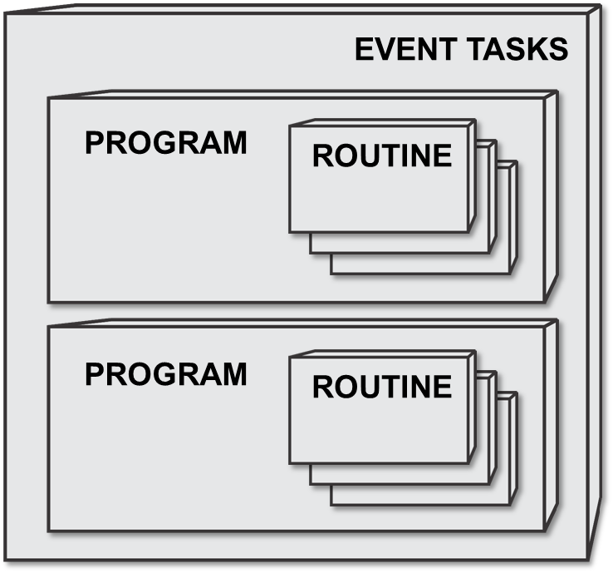
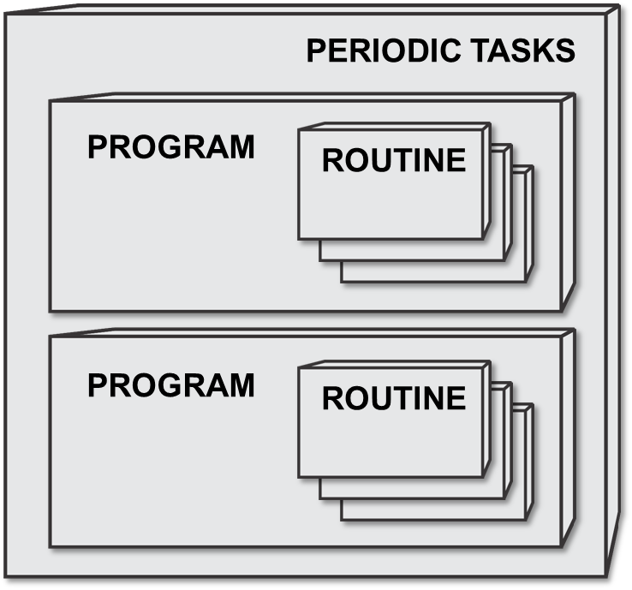
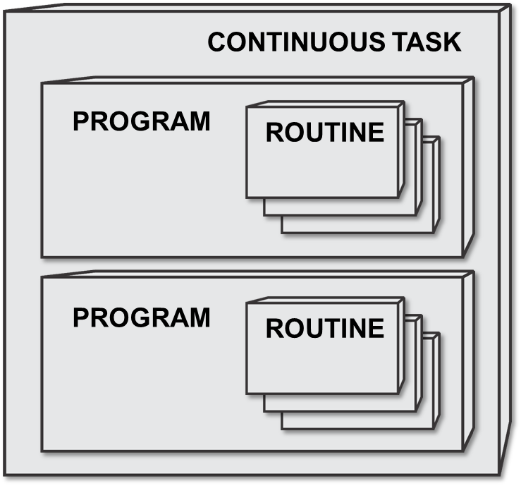
Program Structures
Studio 5000
The Continuous Task and its Program, with the optional additional Programs and Routines, is always scanned, unless…
…interrupted by an invoked Periodic Task
or Event Task.

Slide 15
Program Structures
Studio 5000
These structures allows the programmer to determine when the logic will be executed for most efficient operations.

Slide 16
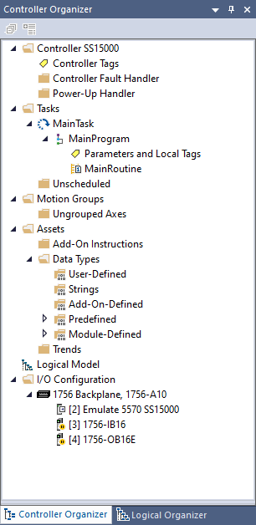

Program Structures
Studio 5000
The Controller Organizer shows the continuous Task, Program, and Routine.
The naming of “MainTask”, “MainProgram”, and “MainRoutine” are the defaults. They can be renamed.

Slide 17
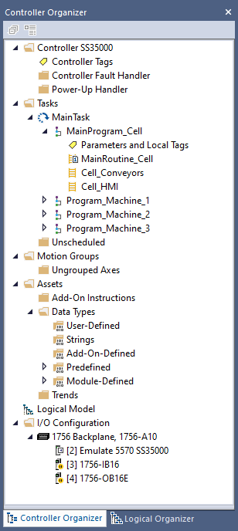
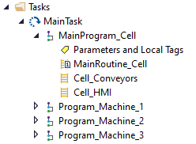
Program Structures
Studio 5000
In this example application.
The Main Program and Routines controls the Sequencing, Conveyors, and HMI for the multiple machining cell.
Additional Programs are defined for each machine.

Slide 18
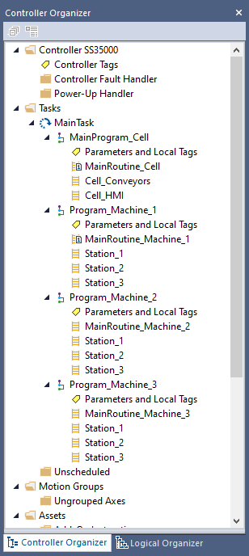
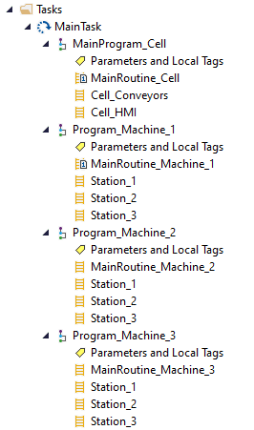
Program Structures
Studio 5000
Programs are scanned in the order listed in the Controller Organizer.
Each machine has its Program and Routines for controlling the Machine’s Stations.

Slide 19
Program Structures
Studio 5000
Multiples of the same machine are used because of production output requirements.
The Local Parameters and Local Tags can be the same in each Program. Not shared between Programs.
This simplifies the programming and troubleshooting because of similar Tags for each machine.

Slide 20
Program Structures
Studio 5000
TASK
Most application will use...
1 TASK
1 PROGRAM
and multiple ROUTINES.
PROGRAM
ROUTINE
The programmer determines if the Periodic or Event TASK and multiple PROGRAMS are to be used for the most efficient operations.

